Slide 1
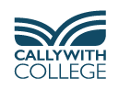
Careers Information Evening
Thursday October 8th
David Sellars – Destinations Lead Teacher

Slide 2

RATIONAL INFORMED CAREER DECISIONS
PROACTIVE

Slide 3
Topics Covered
Importance of CEIAG – Labour Market Trends
Identifying a Job Role(s)
Higher Education
Apprenticeships
Jobs
Gap Year(s)
Careers Programme & Support Available

Slide 4
Changing Labour Market
Technological, Environmental, Social & Economic change
Average number of jobs in UK - 6
Prediction 10 – 15 jobs in working life
Transferable Skills

Slide 5
Transferable Skills
Listening
Communication – oral and written
Ability to work in a team
Organisational
Creativity
Problem-solving
Numeracy
IT
Leadership

Slide 6
Ways of Developing Transferable Skills
Part-time jobs
Volunteering Home - Volunteer Cornwall
Playing sport and taking part in other team activities: acting, music…………………………
During lessons e.g. team-working, meeting deadlines, giving presentations, problem-solving………………
Notes:
Students do not always realise the increasing value of part-time jobs, sport and other team/group activities and voluntary activities to developing transferable skills and strengthening apprenticeship, job and university applications.

Slide 7

Labour Market Information
Cornwall's biggest industries
Floating windfarms could be hosted off Cornwall and Wales, crown estate says | Energy industry | The Guardian

Slide 8
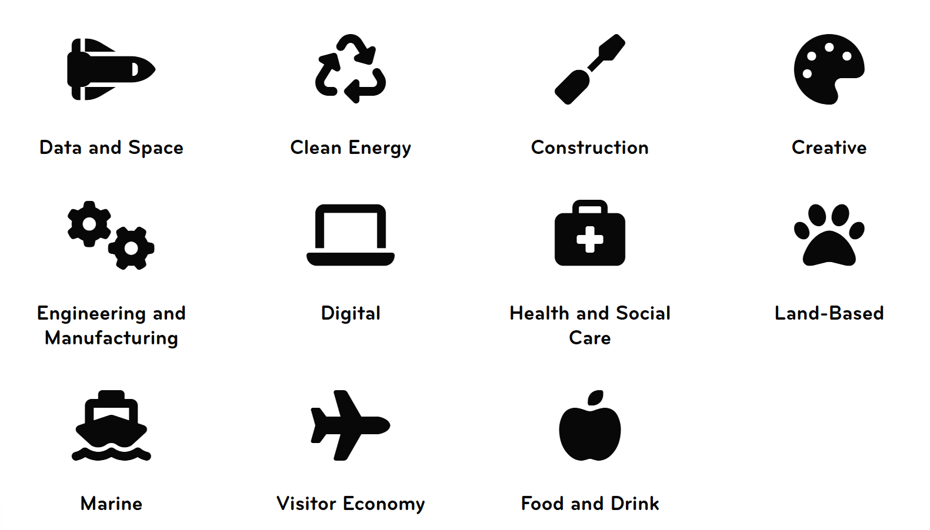

Slide 9
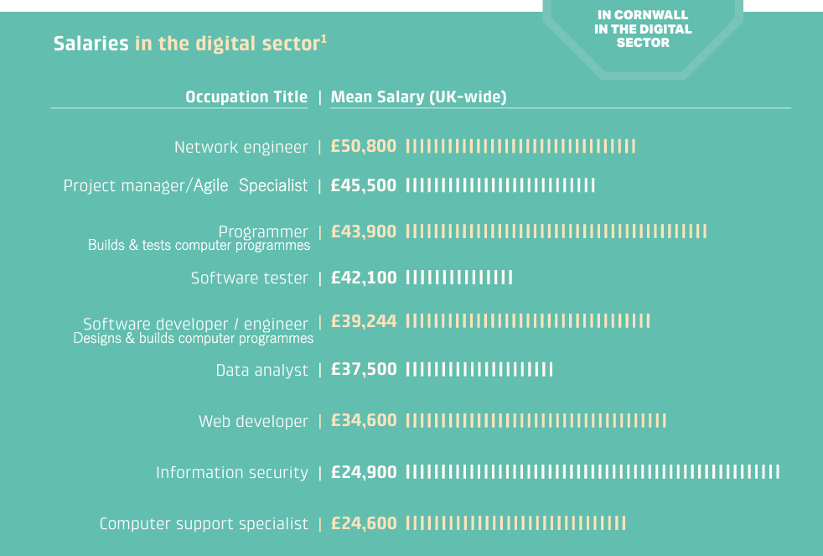

Slide 10
Careers Theories
Traits and Factors Theory – 1909
Frank Parsons focused on “matching an individual’s skills, values, and personality to the requirements of different job roles and environments”
Happenstance Learning Theory – 2014
Krumbolz and Levin “You can create your own ‘unplanned lucky events’ – we can encourage clients to ‘put themselves out there.”

Slide 11
Post-18 Pathways
PDTs (Personal Development Tutors)
Higher Education
Apprenticeships
Gap Year(s)
Job

Slide 12
Careers Provision at Callywith
Careers focused Tutor Sessions
In Diploma and A-level lessons
Events and visits organised by the Destinations Team

Slide 13
Finding a Job Role(s)
Industry Immersion (June 28th – July 2nd)
Destinations Day (November 30th)
Sector Networking Lunches (February and March)
Meet the Alumni Apprentices (National Apprenticeship Week)

Slide 14
Destinations Day 1
Monday 30th November
130+ talks by representatives of 60 businesses, universities & other organisations
Students choose 5 or 6 talks
Opportunity to ask questions

Slide 15
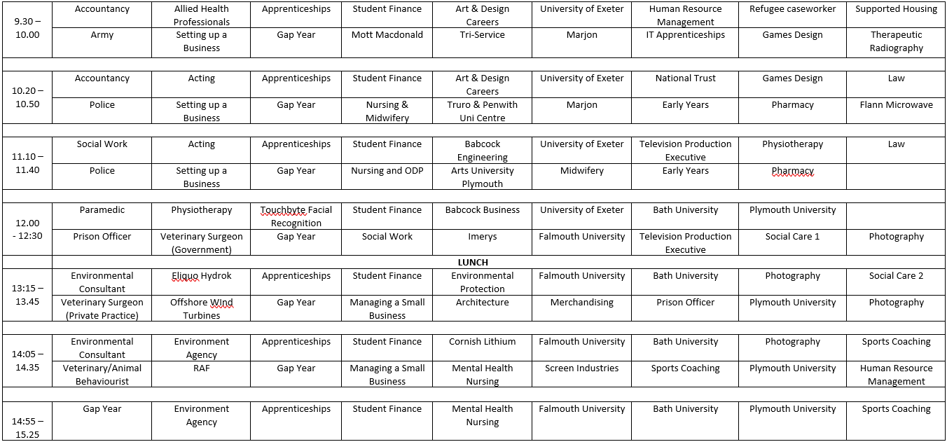
DESTINATIONS DAY 1 (DRAFT) – Monday November 30th

Slide 16
Sector Networking Lunches
Date | Subject Area
 | Social Sciences
 | IT, Maths and Computing
 | Protective Services
 | Science and Engineering
 | Education
 | Art and Photography
 | Media
 | Sport
 | English, Languages and Performing Arts
 | Health and Care
 | Business and Travel & Tourism
 | Humanities

Slide 17
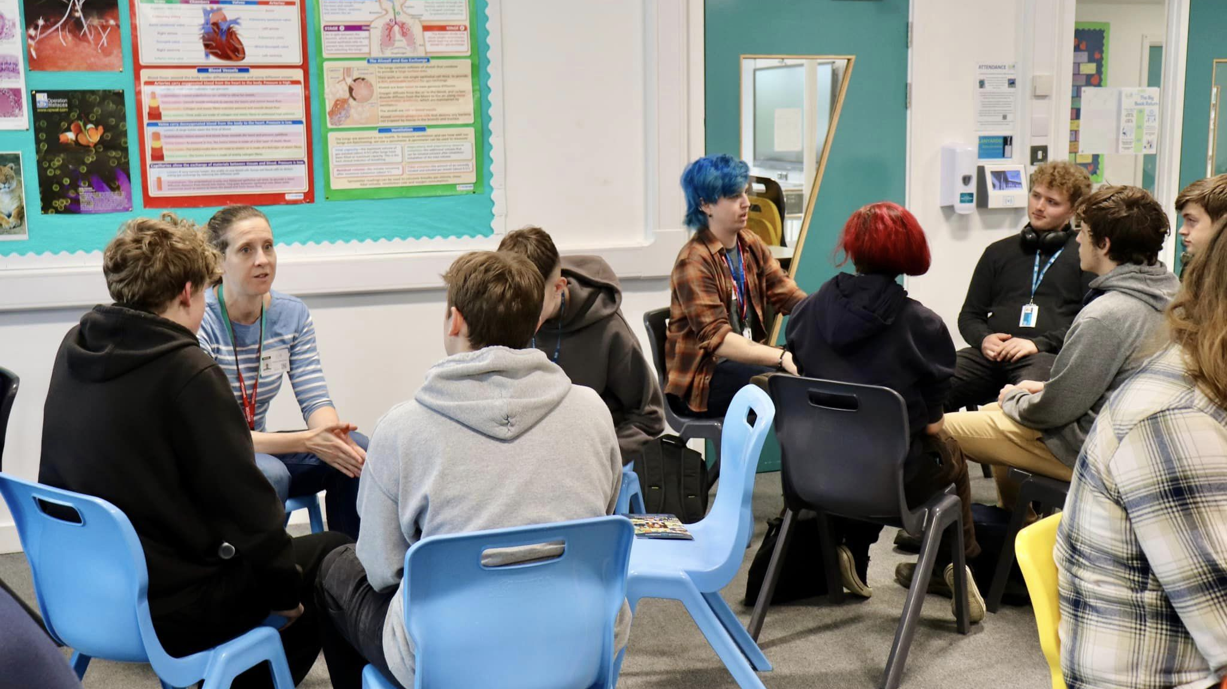
Notes:
Sector networking lunches are chilled and give lots of opportunities to listen to a range of sector specialists and ask questions.

Slide 18
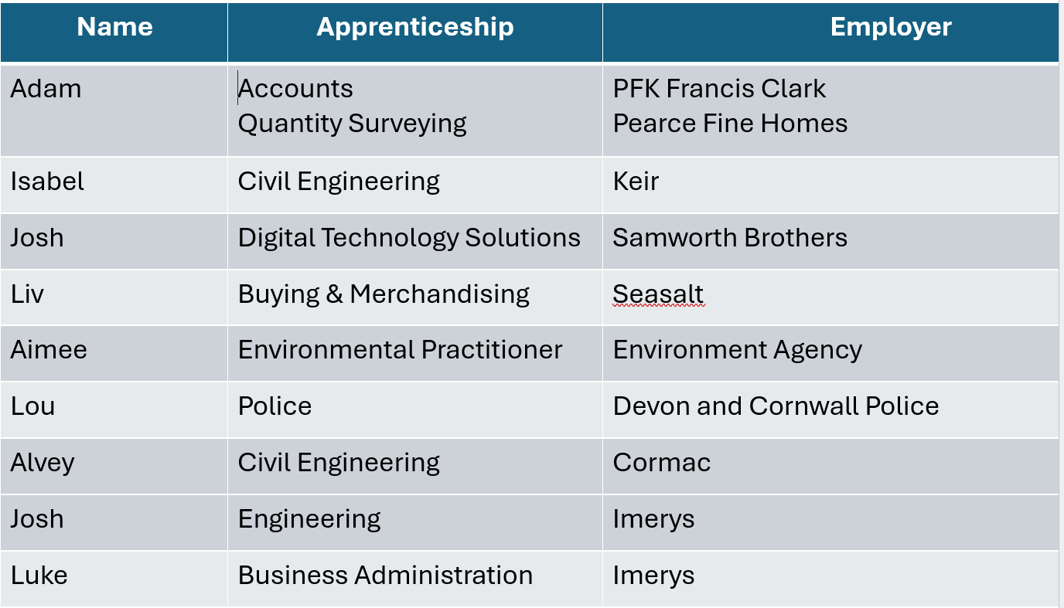

Slide 19

Finding a Job Role(s) - continued
Prospects Website
  Job sectors | Prospects.ac.uk
  Job profiles | Prospects.ac.uk
  One-to-One Careers Meetings

Slide 20



Slide 21


Slide 22
Higher Education
Subject?
Single or joint?
BA or BSc?
Sandwich course?
Russell Group?
Preferred assessment method?
Size? Where? Campus/city?
Exeter University Subject Taster Day – tbc
HE Fair - tbc

Slide 23
Student Finance
Student loans: How do they work, what can I borrow and when do I pay it back? - BBC News
a loan for tuition fees (£9790) and maintenance loan (means tested) to cover living costs
Student finance calculator - GOV.UK (www.gov.uk)
repay once earn £25 000 or above
pay 9% of earnings above £25 000
written off after 40 years

Slide 24

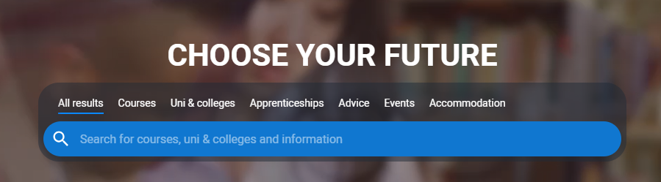
Universities and Colleges Admissions Service

Slide 25
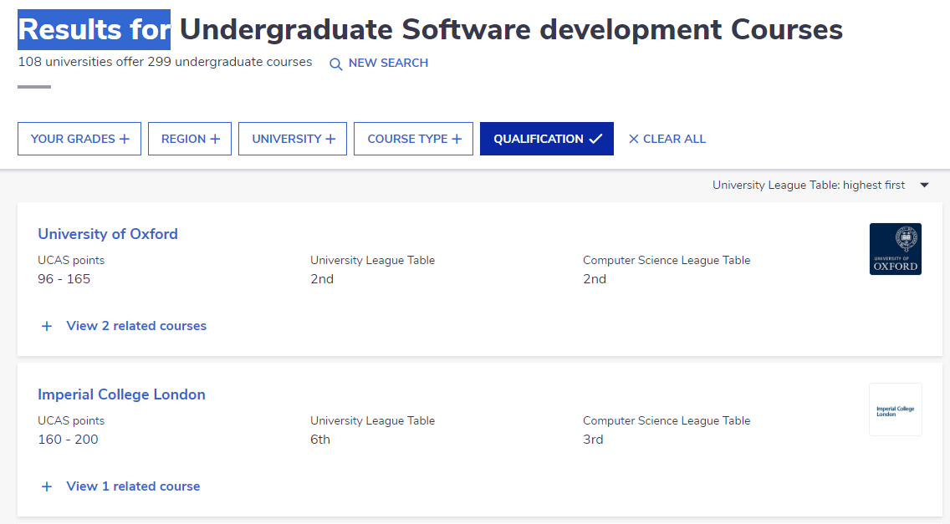
‘The Complete University Guide’
Undergraduate Degree Course Search | Complete University Guide (thecompleteuniversityguide.co.uk)

Slide 26
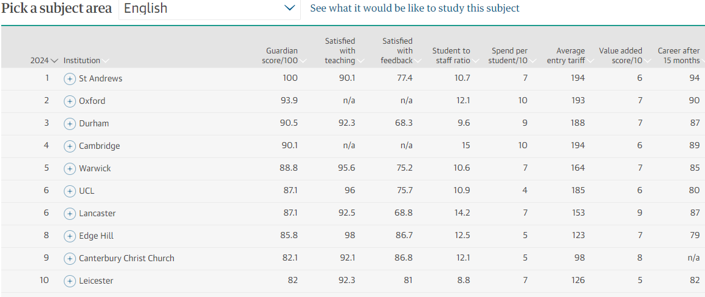
‘Education Guardian University Subjects League Tables’ The Guardian University Guide 2027 – the rankings | University guide | The Guardian

Slide 27
Apprenticeship Levy - 2017
used to fund apprenticeship training.
applies to those with a payroll of more than £3 million (the apprenticeship threshold).
charged at 0.5% of an employer’s total payroll (apprenticeship levy allowance).

Slide 28
Apprenticeship Sectors
Business
Engineering
IT

Slide 29
Apprenticeships
 | Level | Equivalent Educational Level
Foundation (16 – 21 & targeted 22-24) | 2 | GCSE
Intermediate | 2 | GCSE
Advanced | 3 | A-level/National Diploma
Higher | 4 & 5 | HNC & Foundation Degree
Degree | 6 & 7 | Batchelors & Masters Degree

Slide 30
Finding an Apprenticeship
Higher & Degree Vacancy Listing - Amazing Apprenticeships
Find an apprenticeship (findapprenticeship.service.gov.uk)
Apprenticeships (cornwall-opportunities.co.uk)
Search apprenticeships | UCAS

Slide 31


Slide 32
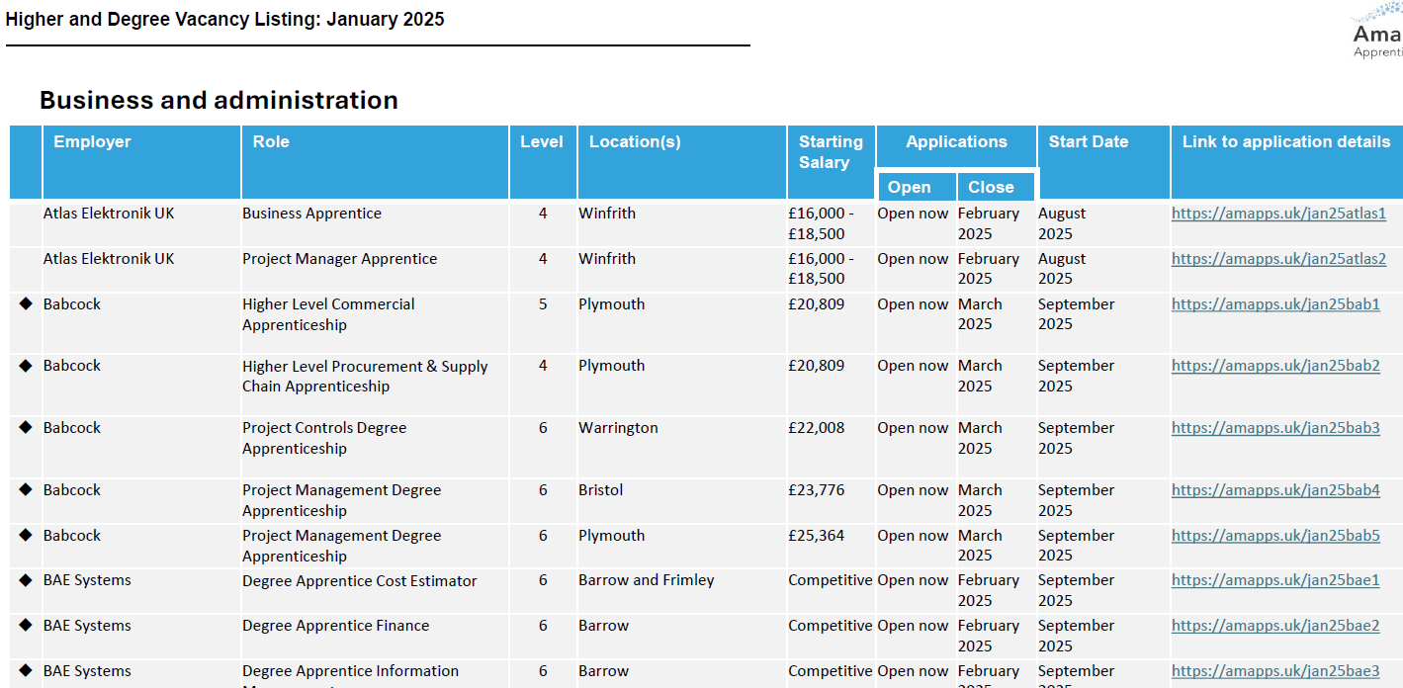
National Higher and Degree Apprenticeships

Slide 33
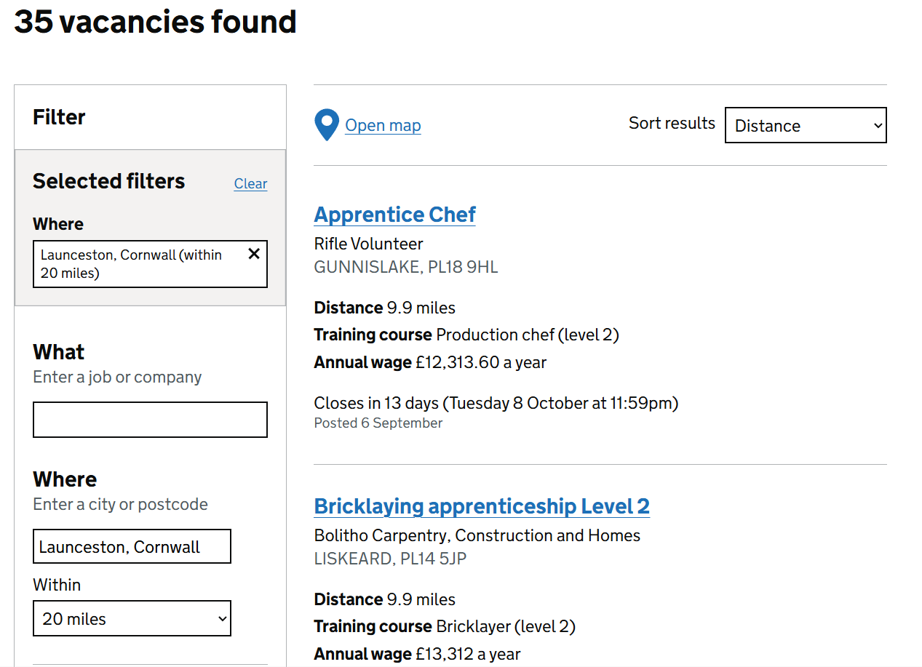
Search for an apprenticeship – Find an apprenticeship – GOV.UK (findapprenticeship.service.gov.uk)

Slide 34
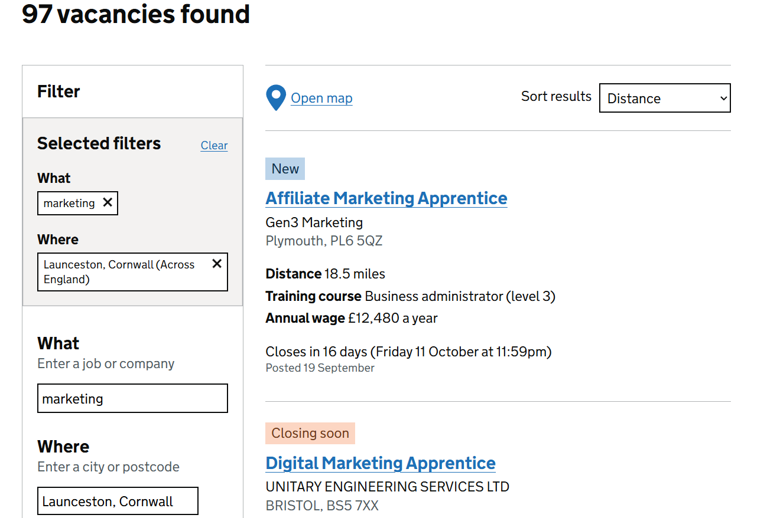

Slide 35
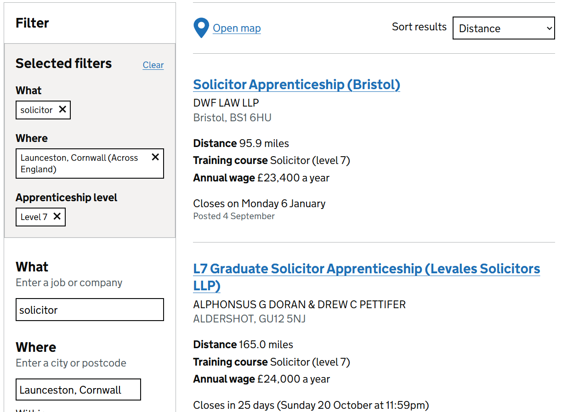

Slide 36
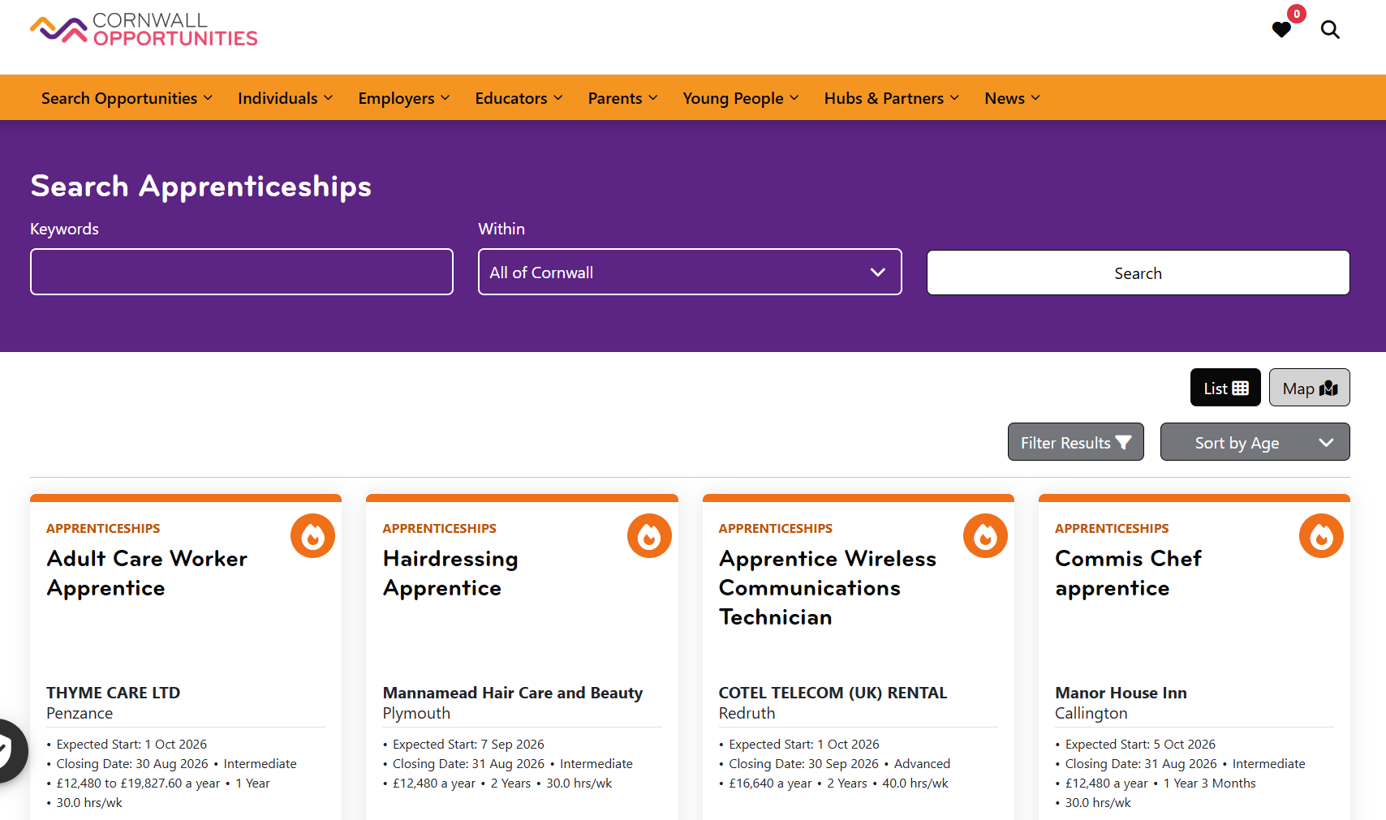

Cornwall Opportunities

Slide 37
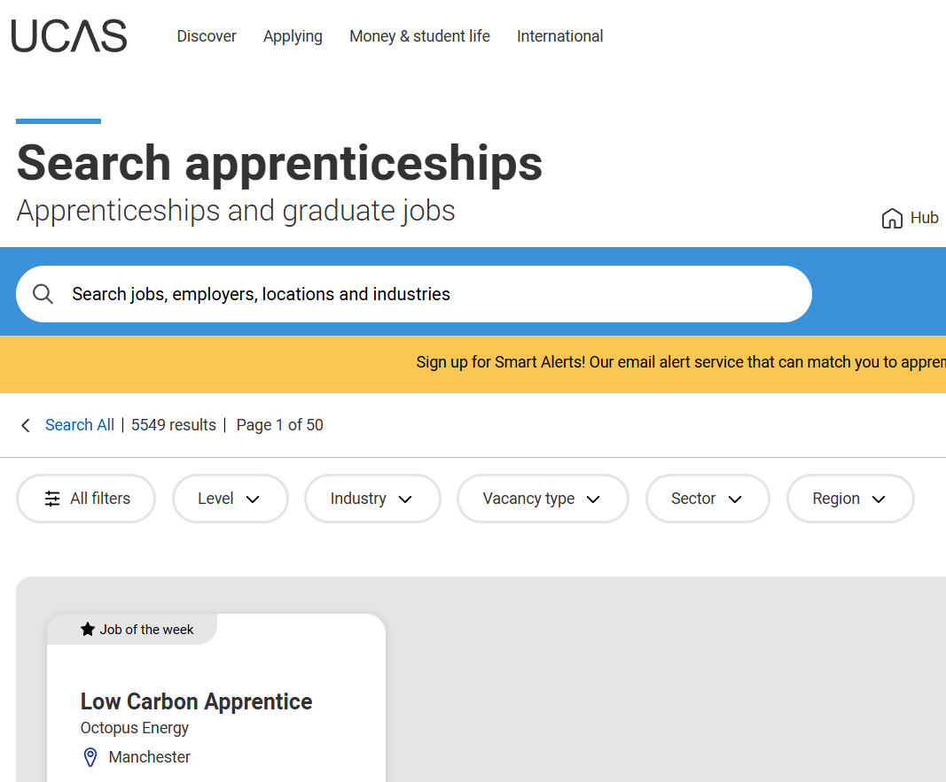
Search apprenticeships | UCAS

Slide 38
University or Degree Apprenticeship?
‘
University | Degree Apprenticeship
Enjoying education | Financial advantages
Independent learners | Applied learners
Full ‘uni experience’
Apply for both? (sandwich degree)

Slide 39
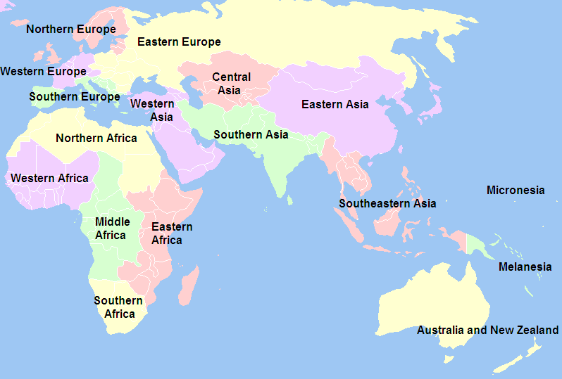

Slide 40
BENEFITS
BREAK FROM STUDY
DEVELOP SKILLS & GAIN EXPERIENCES
TEST OUT A CAREER IDEA
VALUABLE ON CV
TIME TO REFLECT & FOCUS
SAVE MONEY FOR UNIVERSITY

Slide 41
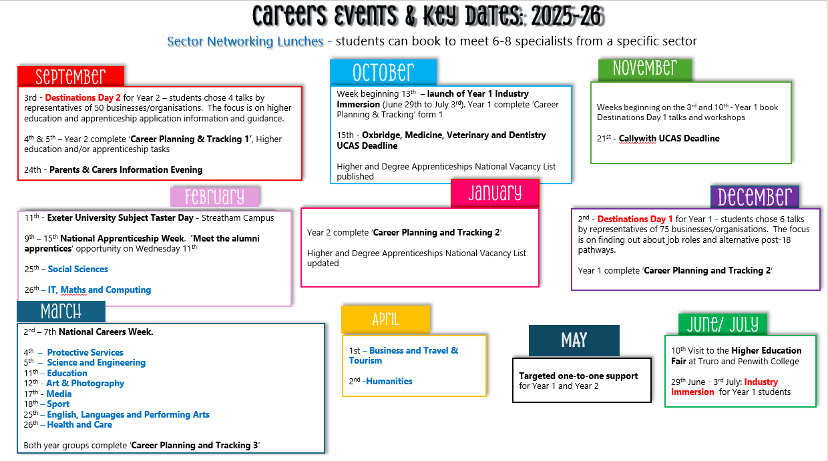

Slide 42

Developing CEIAG at Callywith

Slide 43
Contacts
careers@callywith.ac.uk
davidsellars@callywith.ac.uk Destinations Lead Teacher
moirabawden@callywith.ac.uk Careers & Work Experience Adviser
naomiwilliamson@callywith.ac.uk Work Experience Adviser

Slide 44
Would you like to help?
Destinations Days
Sector Networking Lunches
Provide work experience opportunities

