Slide 1
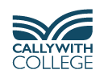
Careers Information Evening Wednesday 24th September
David Sellars – Destinations Lead Teacher
Moira Bawden – Careers and Work Experience Adviser

Slide 2

RATIONAL INFORMED CAREER DECISIONS
PROACTIVE

Slide 3
Topics Covered
Importance of CEIAG – Labour Market Trends
Identifying a Job Role(s)
Higher Education
Apprenticeships
Jobs
Gap Year(s)
Careers Programme & Support Available

Slide 4
Changing Labour Market
Technological, Environmental, Social & Economic change
Average number of jobs in UK - 6
Prediction 10 – 15 jobs in working life
Transferable Skills

Slide 5
Transferable Skills
Listening
Communication – oral and written
Ability to work in a team
Organisational
Creativity
Problem-solving
Numeracy
IT
Leadership

Slide 6
Ways of Developing Transferable Skills
Part-time jobs
Volunteering Home - Volunteer Cornwall
Playing sport and taking part in other team activities: acting, music…………………………
During lessons e.g. team-working, meeting deadlines, giving presentations, problem-solving………………
Notes:
Students do not always realise the increasing value of part-time jobs, sport and other team/group activities and voluntary activities to developing transferable skills and strengthening apprenticeship, job and university applications.

Slide 7

Labour Market Information Cornwall's biggest industries Floating windfarms could be hosted off Cornwall and Wales, crown estate says | Energy industry | The Guardian

Slide 8
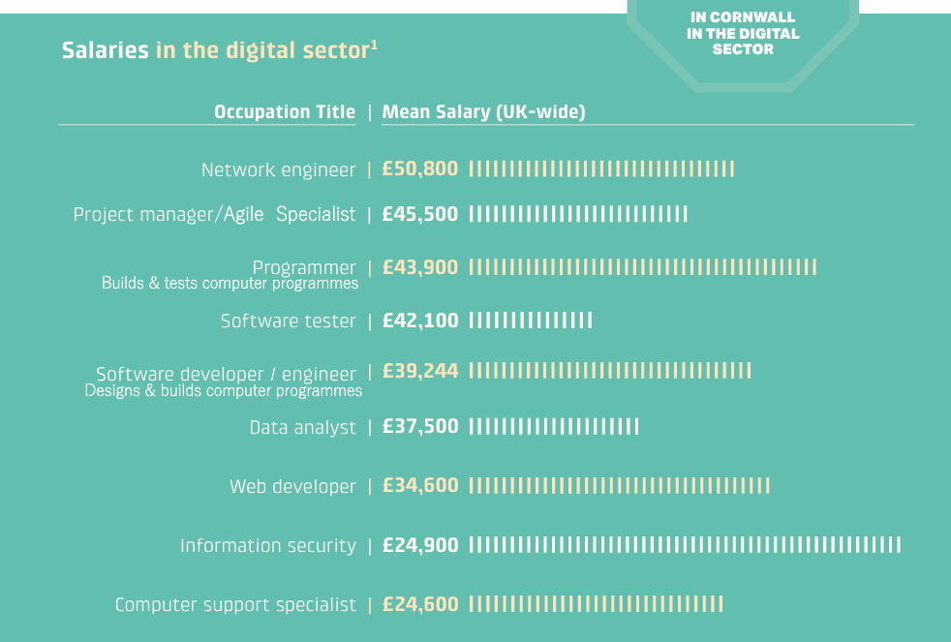

Slide 9
Careers Theories
Traits and Factors Theory – 1909
Frank Parsons focused on “matching an individual’s skills, values, and personality to the requirements of different job roles and environments”
Happenstance Learning Theory – 2014
Krumbolz and Levin “You can create your own ‘unplanned lucky events’ – we can encourage clients to ‘put themselves out there.”

Slide 10
Post-18 Pathways PDTs (Personal Development Tutors)
Higher Education
Apprenticeships
Gap Year(s)
Job

Slide 11
Finding a Job Role(s)
Industry Immersion (June 29th – July 3rd)
Destinations Day – December 2nd
Sector Networking Lunches (end of Feb – April)

Slide 12
Destinations Day
Tuesday 2nd December
120 talks by representatives of 75 businesses, universities & other organisations
Students choose 5 – 6 talks
Opportunity to ask questions

Slide 13
Exeter University | Army | Student Ambassadors
Falmouth University | Navy | Creative Careers
Plymouth University | RAF | Screen Industries
Marjons University | Tri-Service Safety Officer | Broadcast Media Careers
University of Arts Plymouth | Police | Directing & Producing Films
Truro & Penwith University Centre | Fire Service | Architecture
Next Steps – Student Finance | Veterinary Surgeon | Photography
Apprenticeships | Nurse | Civil Engineering (Cormac)
Marketing | Midwife | Babcock
Accountancy | Mental Health Nurse | Imerys
Human Resource Management | Radiographer | Environment Agency
Law | Operating Department Practitioner | IT & Software Development
Starting a Business 1 | Physiotherapy | IT Monitoring & Control Systems
Starting a Business 2 | Psychology | Games Industry Careers
Starting a Sports Business | Pharmacy | Gap Years
Sports Careers | Veterinary Surgeon | Hospitality
Sports Coaching | Social Work | Teaching
Careers in Rugby | Social Care | Working in Supported Housing

Slide 14
Sector Networking Lunches
Date | Subject Area
25/2 | Social Sciences
26/2 | IT, Maths and Computing
4/3 | Protective Services
5/3 | Science and Engineering
11/3 | Education
12/3 | Art and Photography
17/3 | Media
18/3 | Sport
25/3 | English, Languages and Performing Arts
26/3 | Health and Care
1/4 | Business and Travel & Tourism
2/4 | Humanities

Slide 15
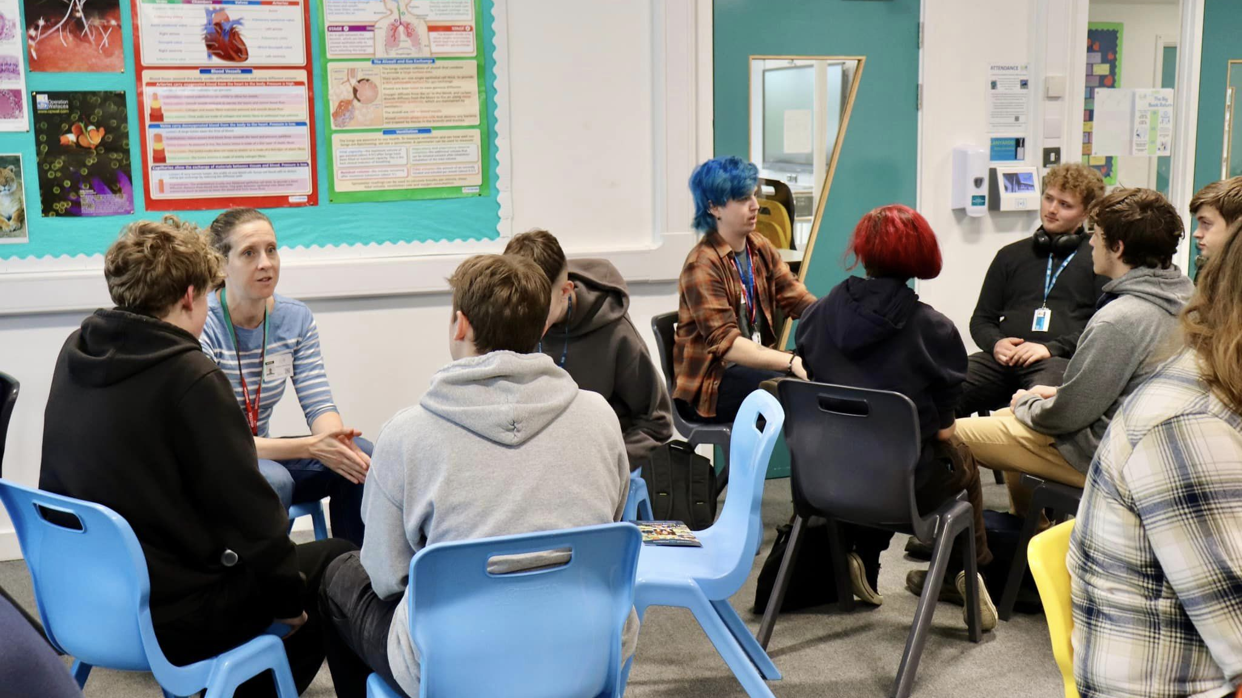
Notes:
Sector networking lunches are chilled and give lots of opportunities to listen to a range of sector specialists and ask questions.

Slide 16
Finding a Job Role(s) - continued
Prospects Website
Job sectors | Prospects.ac.uk
Job profiles | Prospects.ac.uk
Lessons
One-to-One Careers Meetings Destinations Space (office365.com)

Slide 17



Slide 18


Slide 19
Higher Education
Subject?
Single or joint?
BA or BSc?
Sandwich course?
Russell Group?
Preferred assessment method?
Size? Where? Campus/city?
Exeter University Subject Taster Day – 11th February
HE Fair (10th June)

Slide 20
Student Finance
Student loans: How do they work, what can I borrow and when do I pay it back? - BBC News
a loan for tuition fees (up to £9,535 per year)
a maintenance loan (means tested) to cover living costs
Student finance calculator - GOV.UK (www.gov.uk)
repay once earn £25 000 or above
pay 9% of earnings above £25 000
written off after 40 years

Slide 21

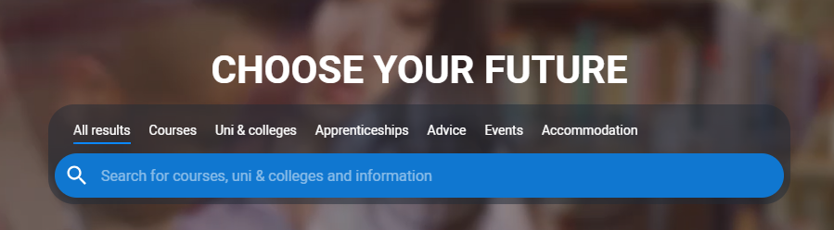
Universities and Colleges Admissions Service

Slide 22
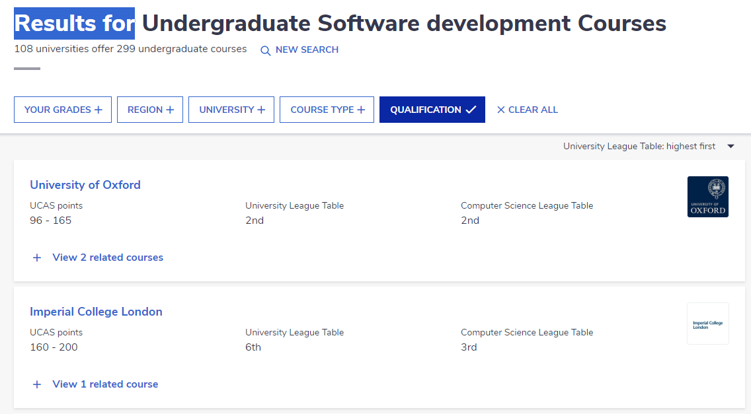
‘The Complete University Guide’ Undergraduate Degree Course Search | Complete University Guide (thecompleteuniversityguide.co.uk)

Slide 23
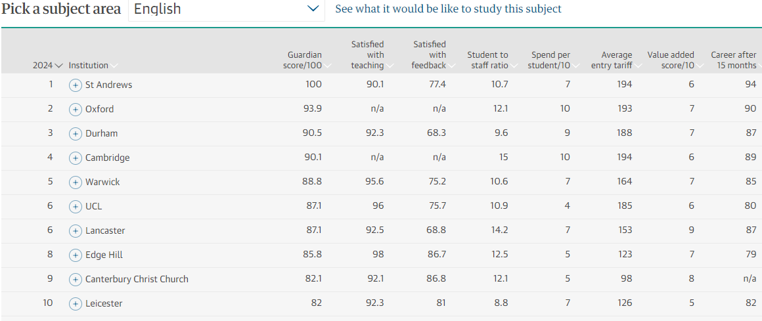
‘Education Guardian University Subjects League Tables’ The Guardian University Guide 2026 – the rankings | University guide | The Guardian

Slide 24
Apprenticeships
Apprenticeship Levy - 2017
Job Roles - apprenticeship standards?
Levels?
Where to find an apprenticeship

Slide 25
Apprenticeship Levy - 2017
used to fund apprenticeship training.
applies to those with a payroll of more than £3 million (the apprenticeship threshold).
charged at 0.5% of an employer’s total payroll (apprenticeship levy allowance).

Slide 26
Apprenticeship Sectors
Business
Engineering
IT

Slide 27
Apprenticeship Levels
 | Level | Equivalent Educational Level
Intermediate | 2 | GCSE
Advanced | 3 | A-Level/ National Diploma
Higher | 4 & 5 | HNC & Foundation degree
Degree | 6 & 7 | Batchelor’s (6) or Masters (7) degree

Slide 28
Finding an Apprenticeship
Higher & Degree Vacancy Listing - Amazing Apprenticeships
Find an apprenticeship (findapprenticeship.service.gov.uk)
Apprenticeships (cornwall-opportunities.co.uk)
Search apprenticeships | UCAS

Slide 29


Slide 30
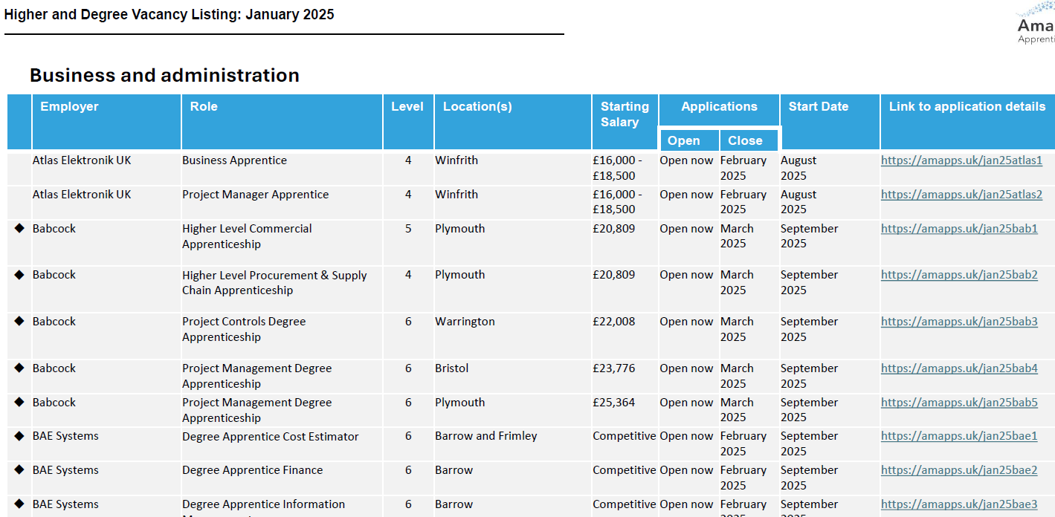
National Higher and Degree Apprenticeships

Slide 31
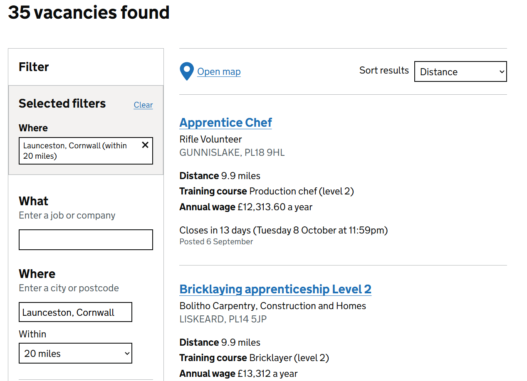
Search for an apprenticeship – Find an apprenticeship – GOV.UK (findapprenticeship.service.gov.uk)

Slide 32
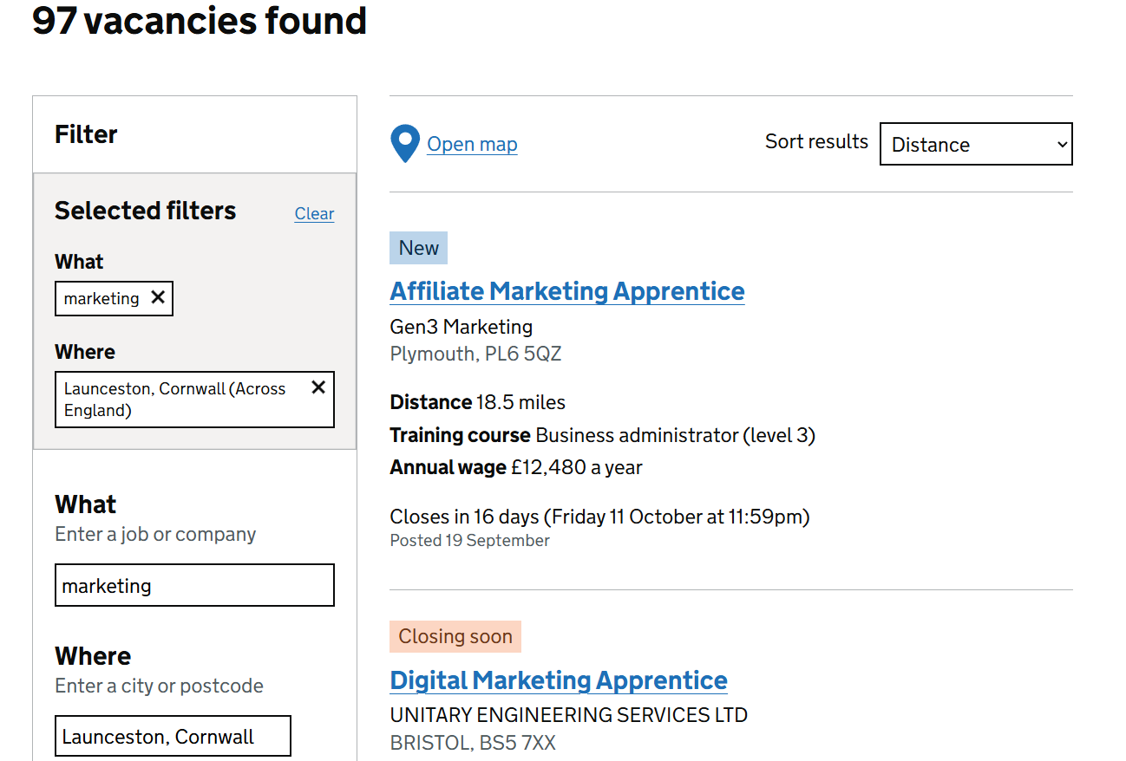

Slide 33
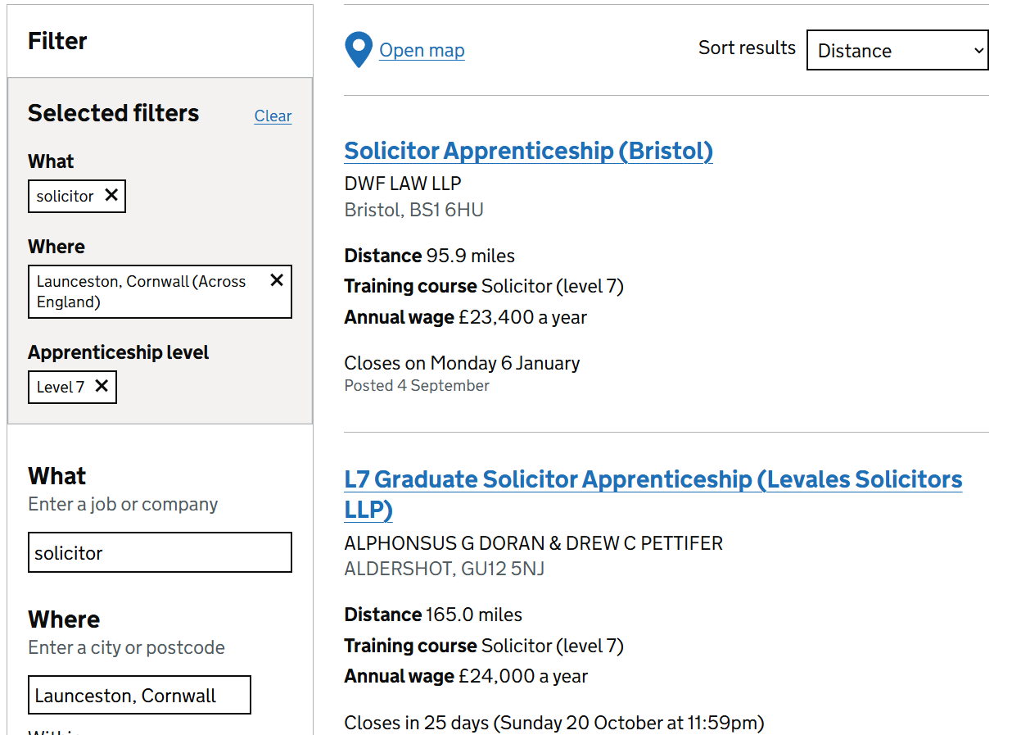

Slide 34

Cornwall Opportunities

Slide 35
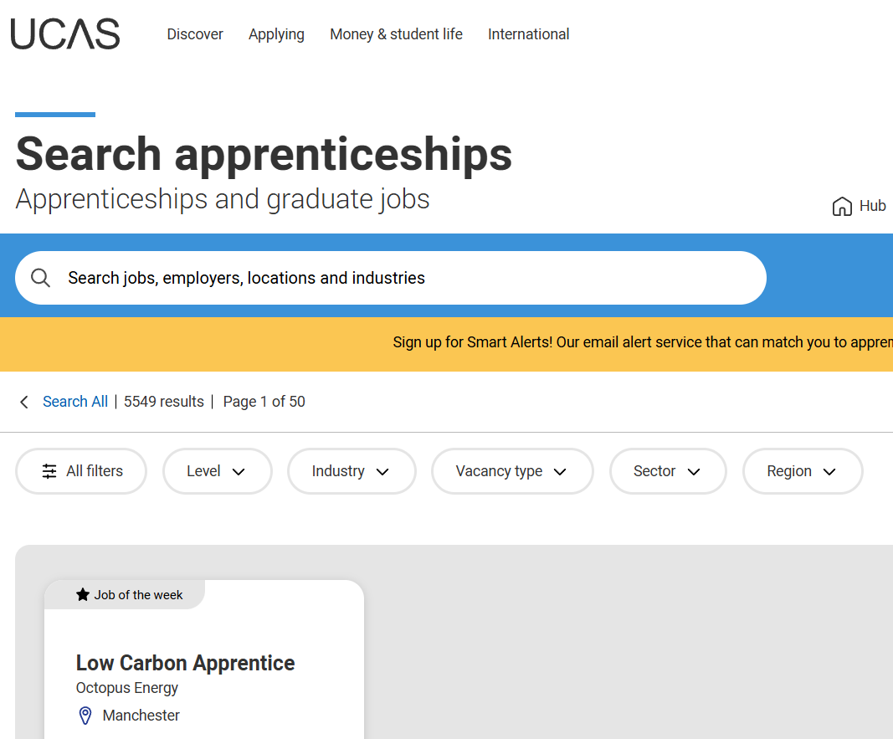
Search apprenticeships | UCAS

Slide 36
University or Degree Apprenticeship?
‘
University | Degree Apprenticeship
Enjoying education | Financial advantages
Independent learners | Applied learners
Full ‘uni experience’
Apply for both? (sandwich degree)

Slide 37
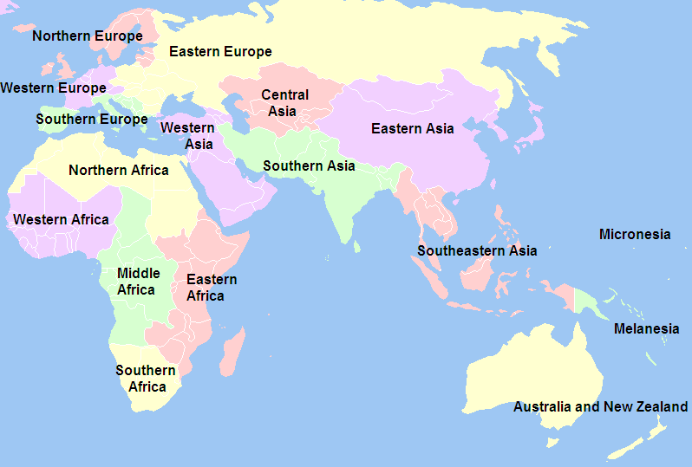

Slide 38

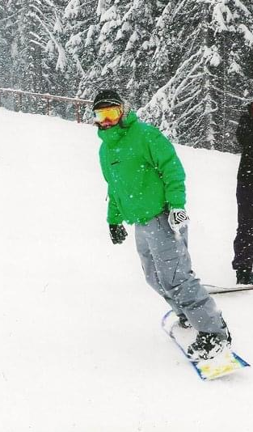
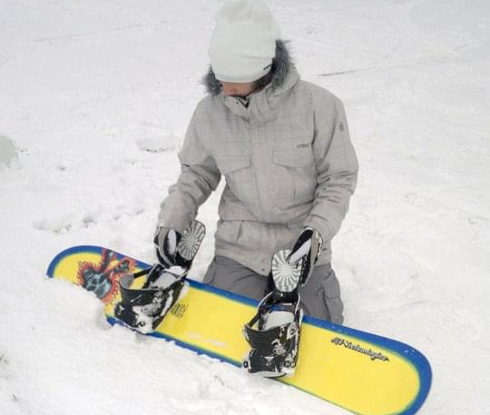
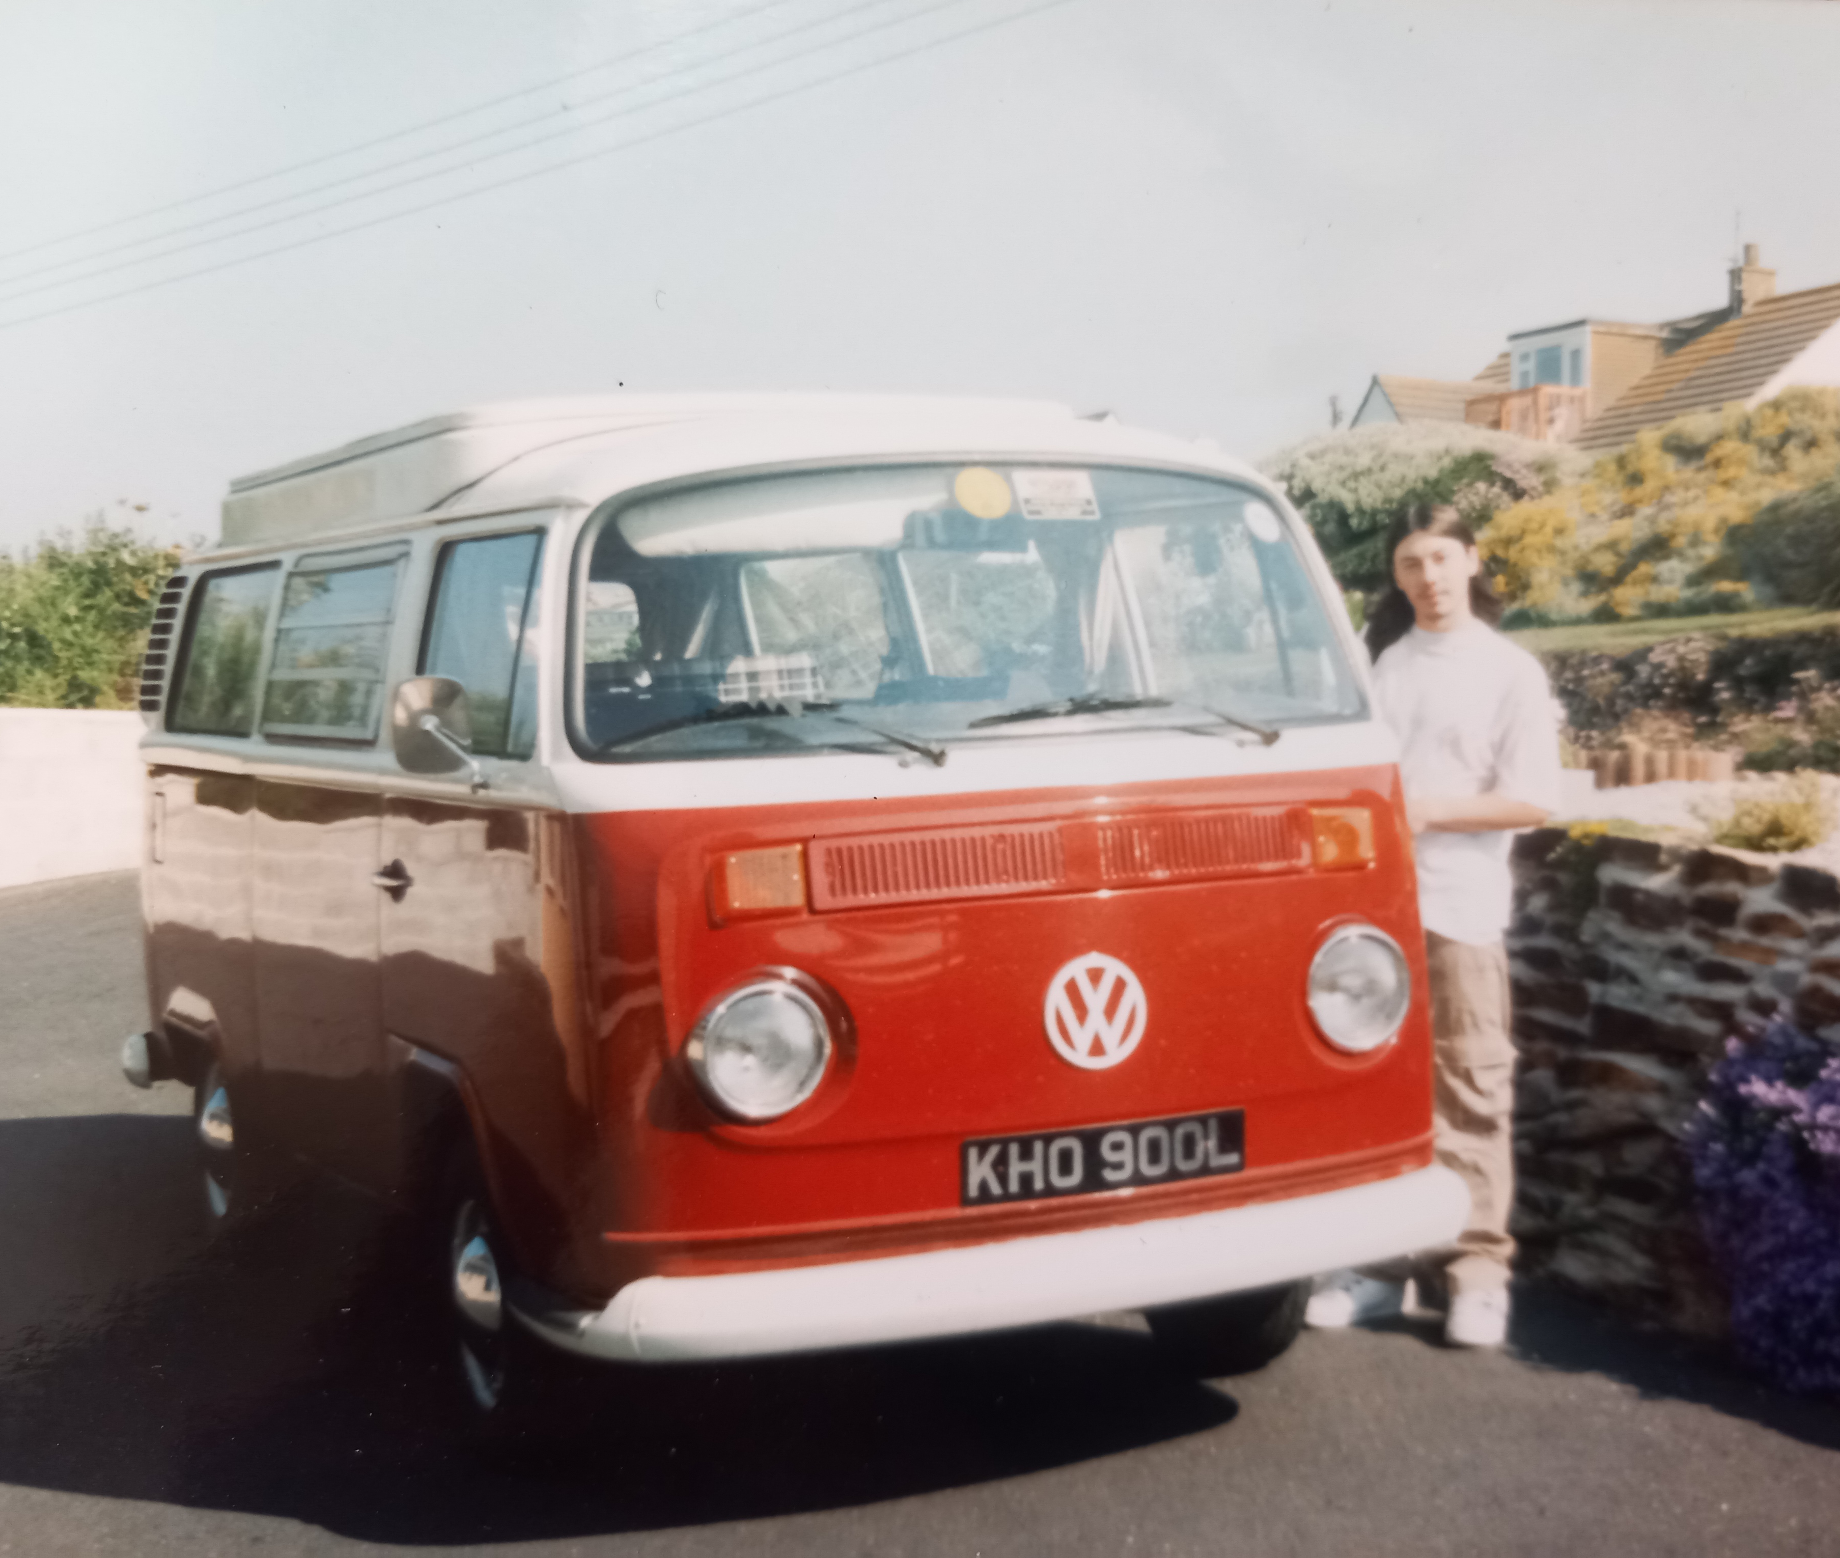


Slide 39
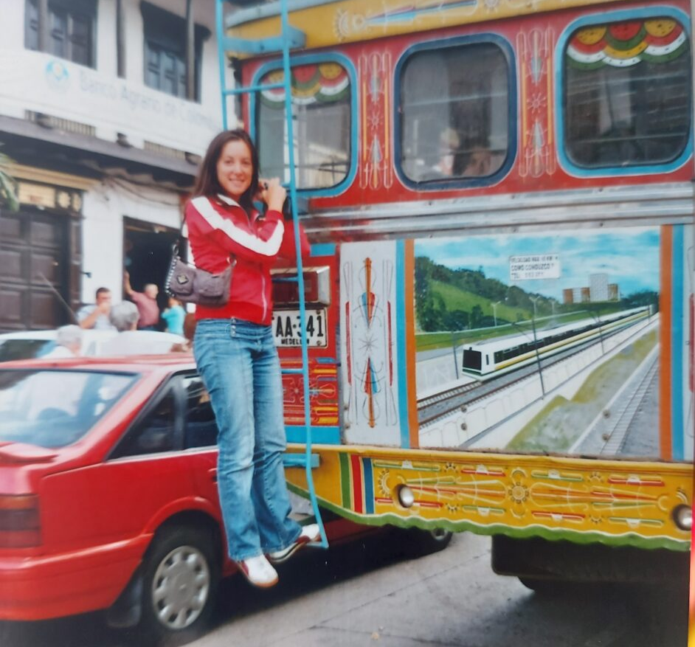
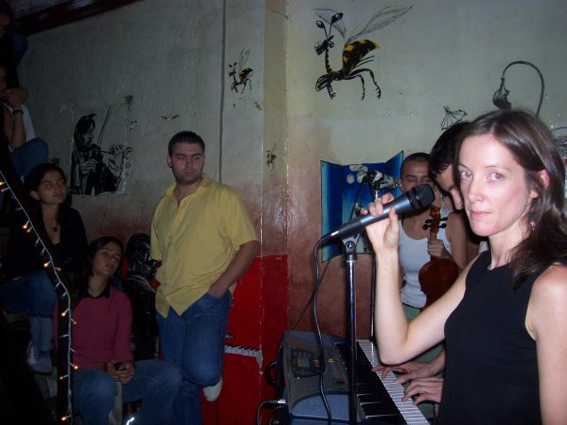

Cultural immersion

Slide 40
BENEFITS
BREAK FROM STUDY
DEVELOP SKILLS & GAIN EXPERIENCES
TEST OUT A CAREER IDEA
VALUABLE ON CV
TIME TO REFLECT & FOCUS
SAVE MONEY FOR UNIVERSITY

Slide 41
Careers Provision at Callywith
Events and visits organised by the Destinations Team
Careers focused Tutor Sessions
In Diploma and A-level lessons

Slide 42
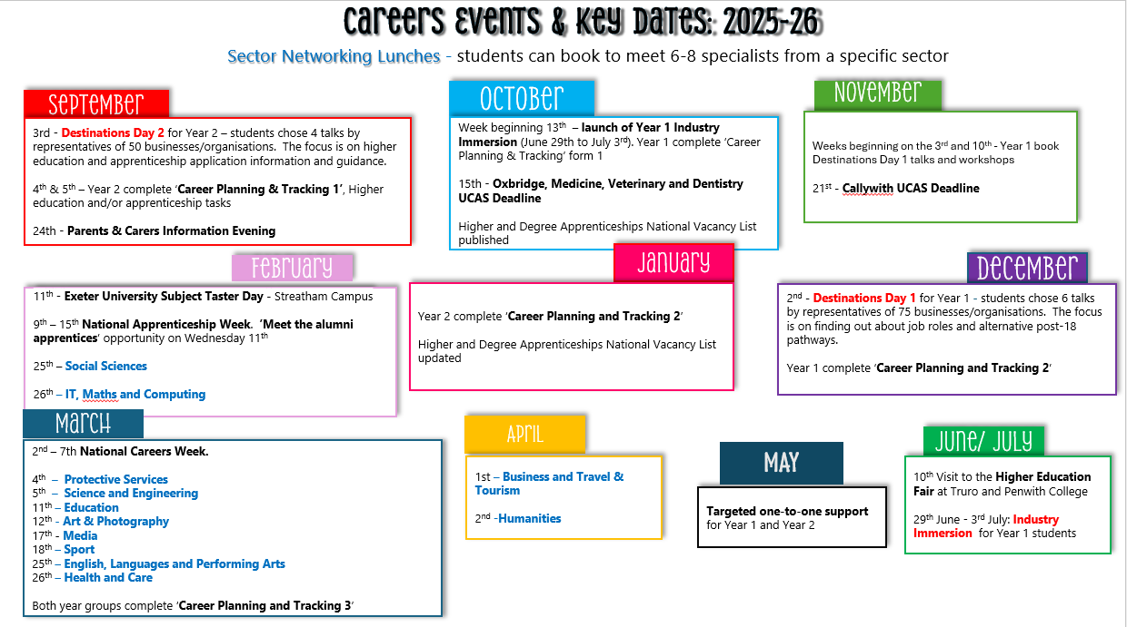

Slide 43

Developing CEIAG at Callywith

Slide 44
Contacts
careers@callywith.ac.uk
davidsellars@callywith.ac.uk Destinations Lead Teacher
moirabawden@callywith.ac.uk Careers Adviser & Work Experience Coordinator

Slide 45
Would you like to help?
Destinations Days
Sector Networking Lunches
Provide work experience opportunities

