Slide 2
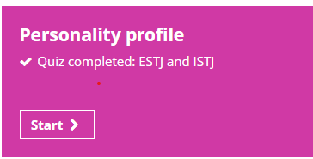
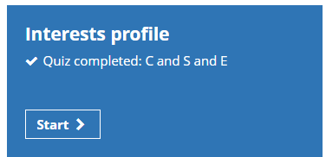
What if you have not identified a potential job role or roles?
Unifrog has some tools to help you. Completing the interests and personality quizzes may help you identify an appealing job role or roles that play to your strengths. The Careers Library enables you to complete searches by college subjects and a ‘keyword’ (job title). Watch the film and look at the profile for some of the ‘Close matches’. If you like a profile ‘Save it to favourites’.
Book a careers meeting

Slide 3
How to find an apprenticeship?
Use the Find an Apprenticeship and/or the Unifrog Apprenticeship search tool to identify vacancies in your area using your postcode
Monitor the Cornwall Apprenticeships website
Higher and Degree Apprenticeship Vacancies – a list of national companies and the higher and degree level apprenticeships they offer (some will be in the Southwest).
Get My first Job and Indeed – both these sites enable you to search for apprenticeships as well as jobs
Research and contact companies – it is important to be proactive when trying to find an apprenticeship. If for example you want to train to be an accountant identify all the accountants that you could travel to and look at their websites for information on careers and vacancies. If you are interested in a gaining an apprenticeship at a business, send them your CV requesting they send you details of future apprenticeship vacancies.

Slide 4
Preparing for an Apprenticeship
Local companies will not start advertising vacancies for next summer (some national companies will!) until the New Year. However, you need to get an understanding of the types of vacancies that are available in your ‘travel to work’ area. Start regularly monitoring the apprenticeships being advertised.
Look for work experience/shadowing opportunities that enable you to find out more about a job role you are interested in.
Complete the ‘Activities’ and ‘Competencies’ sections of Unifrog to help you when updating/producing your CV.
As Covid restrictions are relaxed, look for opportunities to continue to develop and demonstrate your transferable skills through part-time jobs, volunteering and taking part in team activities.
Produce an up-to-date high quality focused CV (focused on the type of apprenticeship you are going to apply for). You can tweak this each time you apply for a slightly different apprenticeship. You can update an existing CV or produce one using Unifrog.
Draft a ‘covering letter’.

Slide 5
Searching for a Job
An option once 18
Look for training and progression opportunities
Get My first Job and Indeed
Look for work experience/shadowing opportunities
Complete the ‘Activities’ and ‘Competencies’ sections of Unifrog
Look for opportunities to continue to develop and demonstrate your transferable skills through part-time jobs, volunteering and taking part in team activities.
Produce an up-to-date high quality focused CV
Draft a ‘covering letter’.

Slide 6
University Research using Unifrog searches
This is an excellent tool for identifying courses you might like to study at university. Search either by entering a key word or/and by entering your current course or courses. Start by clicking on ‘close match’ to look at courses that closely match your keyword and/or your currents course(s)
Read the first page. On the third page enter the ‘best grades you are likely to get by the time you leave school/college’. Enter a subject you are interested in studying. Then click on any of the ‘subjects you might like’ that interest you.
Use the ‘filters’ to narrow your search. You may want to be in a particular region or would like a sandwich course (one with a placement year) or ……………….. Then use the ‘rank’ feature to help you identify the most attractive university for the course you are interested in.

Slide 7
University League Tables
The best UK universities 2021 – rankings | University guide | The Guardian
Top UK University League Tables and Rankings 2022 - Complete University Guide (thecompleteuniversityguide.co.uk)

Slide 8
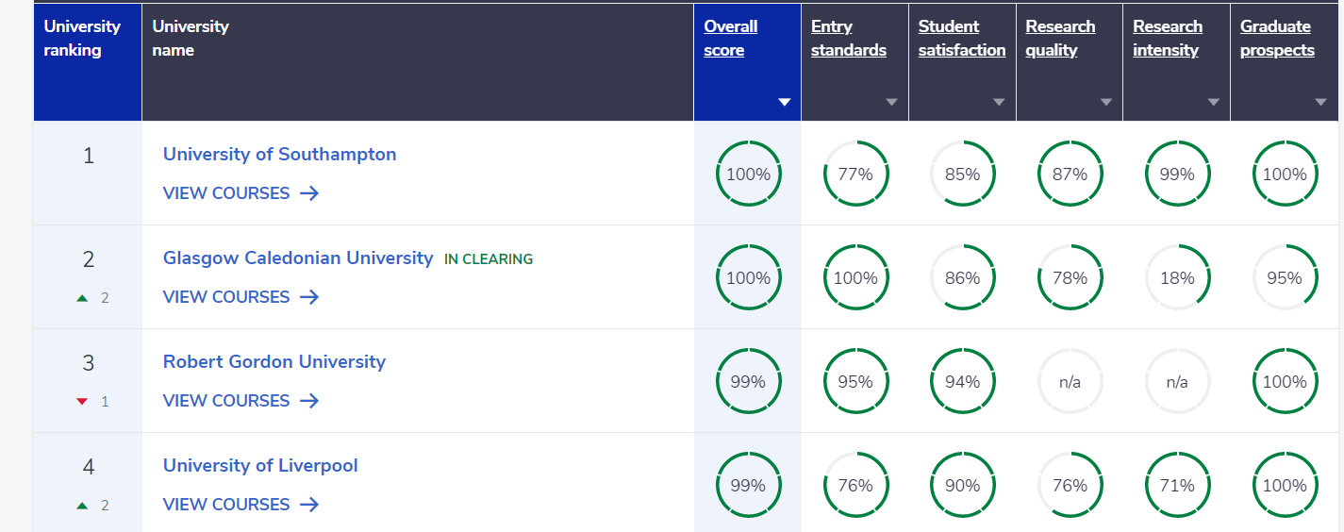

Slide 9
UCAS Application
Use the ‘Applying to UCAS’ Student Preparation Workbook to help you complete your application.
Deadlines:
Oxford, Cambridge, Medicine, Veterinary Science or Dentistry – Friday 17th September – to ensure the UCAS deadline of Thursday October 15th is met.
All other universities and courses – Friday 26th November to ensure
the UCAS Deadline of Wednesday 26th January is met.
Continue drafting your ‘Personal Statement’ as this takes time and is a key element of your application.

